Slide 1
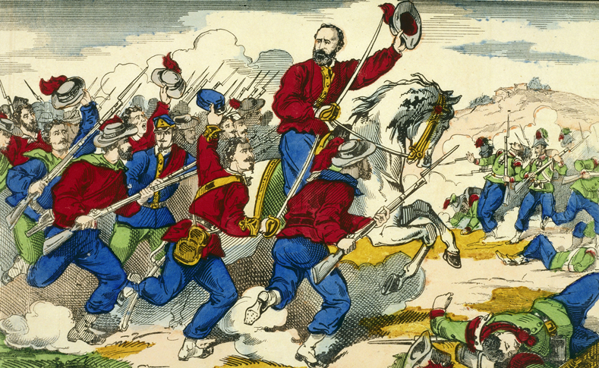
Nationalism and the Spread of Democracy (1790–1914)
Topic 8 Lesson 4 The Unification of Italy

Slide 2
Nationalism and the Spread of Democracy (1790–1914)
Topic 8 Lesson 4 The Unification of Italy
Learning Objectives
List the key obstacles to Italian unity.
Evaluate the roles played by Cavour and Garibaldi in Italian unification.
Describe the challenges that faced the new nation of Italy.

Slide 3
Nationalism and the Spread of Democracy (1790–1914)
Topic 8 Lesson 4 The Unification of Italy
Key Terms
Camillo Cavour
Giuseppe Garibaldi
anarchists,
emigration,

Slide 4
First Steps to Italian Unity
Obstacles to Unity
Invasions by Napoleon will inspire unity
The Austrian empire wants Italy divided
Between 1820-1848 nationalists will organize and revolt. The Austrians will put them down
Mazzini's Young Italy
In the 1830’s Giuseppe Mazzini will set up the Young Italy society. This is a secret society to unify Italy
In 1849 Mazzini will set up a radical republic in Rome. It will be toppled by the French and Mazzini will be exiled
Nationalism Spreads
It will spread because of a shared language, traditions, and history
It will also make more economic sense for Italy as well

Slide 5
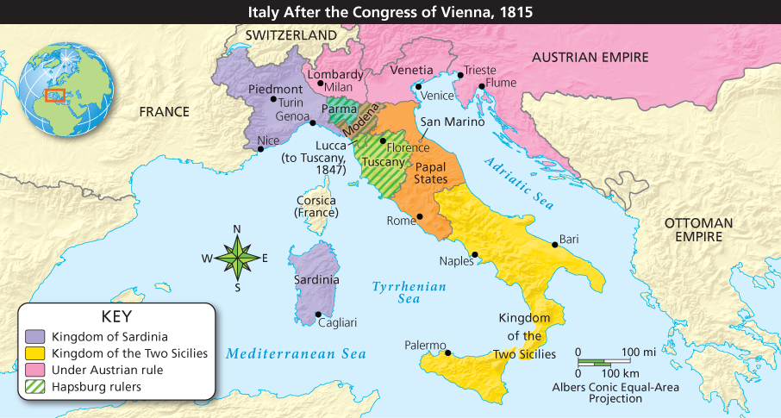
First Steps to Italian Unity
Analyze Maps On the Italian peninsula, the Congress of Vienna gave Austria control of the north, while monarchs ruled other Italian states. Which Italian states were controlled directly by Austria? Which were ruled by Hapsburgs?

Slide 6
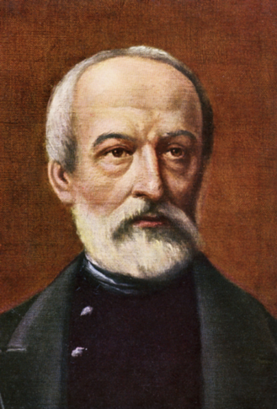
First Steps to Italian Unity
Giuseppe Mazzini, the founder of Young Italy, dreamed of a unified Italian republic. Due to his failed attempts at revolution, he spent many years in exile but continued to inspire Italian nationalism.

Slide 7
The Struggle for Italy
Cavour, a Crafty Politician
In 1852 Cavour becomes Sardinia’s Prime minister
He reforms Sardinia’s economy, but long-term plans is to recover 2 northern Italian provinces from Austria
Cavour Plots with France
In 1858 Cavour agrees a secret deal with France for help against Austria if they go to war and they do. France and Cavour win, and Cavour gets the provinces from Austria. Other northern Italian areas also rebel and join Sardinia
Garibaldi’s “Red Shirts”
Garibaldi, in the south, will recruit fighters and with Cavour’s help will land in Sicily with weapons
Garibaldi will take control of Sicily quickly and head toward Naples

Slide 8
The Struggle for Italy
Unity Achieved
Cavour, afraid that Garibaldi would set up his own republic in the south, sends Sardinian troops to Naples. The troops go and Garibaldi turns over Sicily and Naples to them and Sardinian king Victor Emmanuel
With the Franco Prussian war of 1870, France takes troops out of Rome and Italy is once again a united land

Slide 9
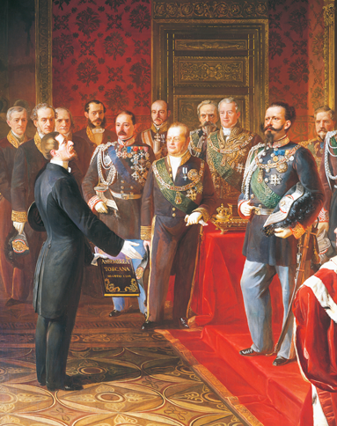
The Struggle for Italy
Prime Minister Cavour (middle) served Sardinia’s King Victor Emmanuel II ( right) with great success. Cavour improved the economy and brought other Italian states under Sardinian rule.

Slide 10
Italy Faces New Challenges
Regional Differences
North had more wealth and cities. South was more agrarian
Conflict with the Papal States
The Church, angry with its treatment, told its petitioners not to cooperate with the new kingdom
Political and Social Turmoil
Few men had the right to vote. The government was conservative
Socialists and anarchists strike and sabotage to force change
The government will pass laws to improve conditions and will try to take over Ethiopia to distract attention at home
Economic Progress
There will be some economic progress in Italy. Factory jobs will help
The population growth will cause tension but emigrating to the United States, Canada, and Latin America will help

Slide 11
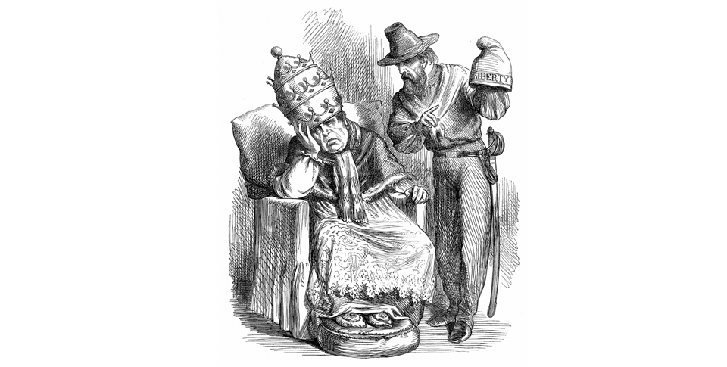
Italy Faces New Challenges
Analyze Political Cartoons Garibaldi suggests that Pope Pius IX trade his papal cap for the cap of 'liberty' that he offers. What does Garibaldi want? How do you think the Pope feels about the offer?

Slide 12
Quiz: First Steps to Italian Unity
What was the goal of Young Italy?
A. to keep Italy divided into separate city states
B. to unite Italy into an independent, republican nation
C. to unite Italy under an absolute monarch
D. to separate Italy into north and south regions, each with its own government

Slide 13
Quiz: The Struggle for Italy
Which Italian nationalist used Realpolitik techniques to strengthen Sardinia’s economy?
A. Giuseppe Garibaldi
B. Victor Emmanuel
C. Giuseppe Mazzini
D. Camillo Cavour

Slide 14
Quiz: Italy Faces New Challenges
What was one post-unification issue that encouraged some Italians to emigrate?
A. rapid population growth
B. encouragement of the Catholic Church
C. expansion of rural farmlands
D. required service in the military

